Slide 1
Asynchronous Programming, Events,
Block scope variables, Constant.

Slide 2
Asynchronous Programming
Both JavaScript in browser, and in Node.js, are single-threaded.
In synchronous programs, if you have two lines of code (L1 followed by L2), then L2 cannot begin running until L1 has finished executing.
In asynchronous programs, you can have two lines of code (L1 followed by L2), where L1 schedules some task to be run in the future, but L2 runs before that task completes.

Slide 3
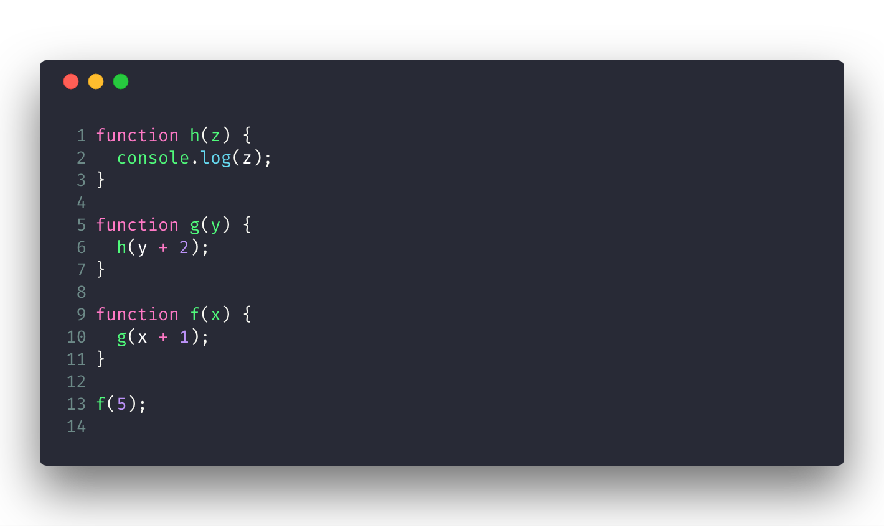
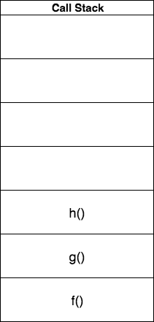
Asynchronous Programming
Call Stack

Slide 4
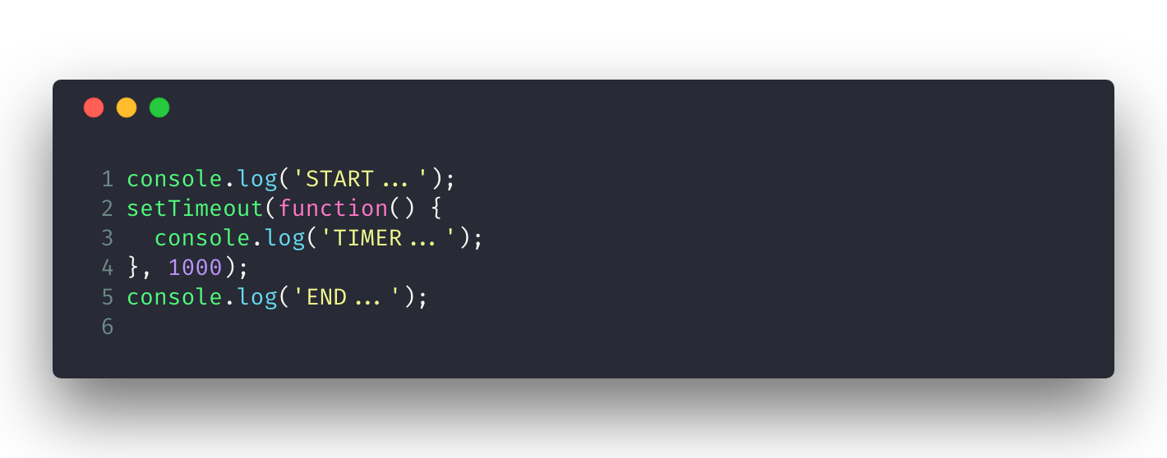
Asynchronous Programming
Web Browser API

Slide 5
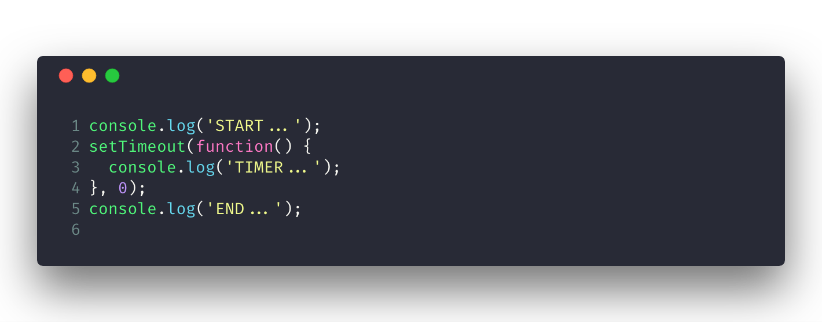
Asynchronous Programming
Web Browser API

Slide 6
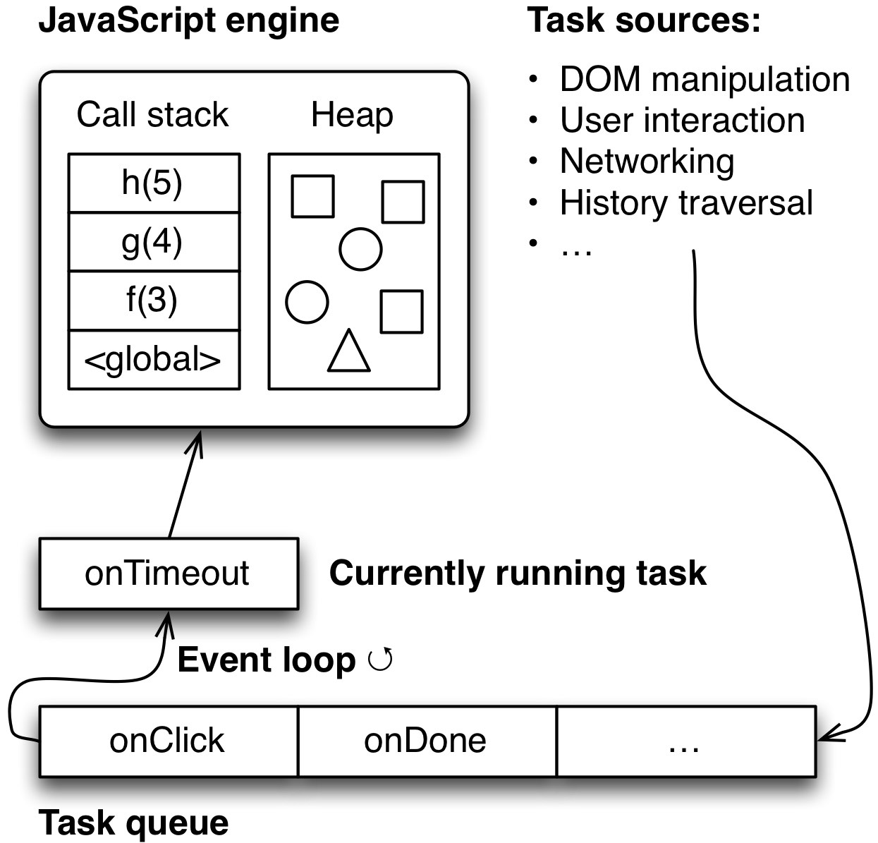
Asynchronous Programming
Event Loop
https://www.youtube.com/watch?v=8aGhZQkoFbQ

Slide 7
Asynchronous Programming
Event Loop: The reality is that all JavaScript executes synchronously - it's the event loop that allows you to queue up an action that won't take place until the loop is available some time after the code that queued the action has finished executing.

Slide 8
Asynchronous Programming
Callback:
Pros: Easy to understand (only for simple callback function).
Cons: Error handling becomes more complicated, Composition is more complicated (Callback hell)

Slide 9
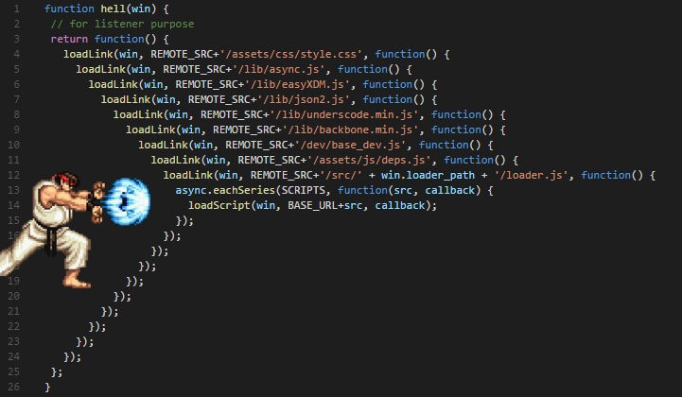
Asynchronous Programming
Callback:

Slide 10
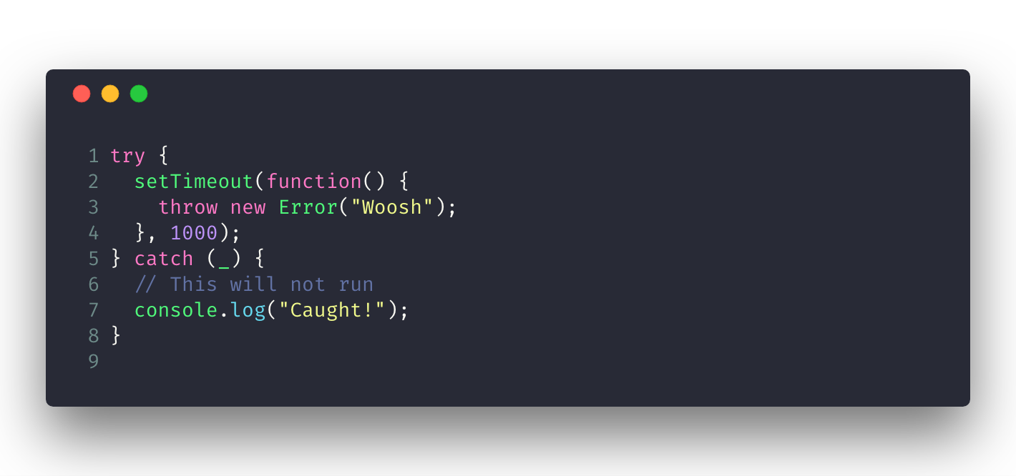
Asynchronous Programming
Callback:

Slide 11
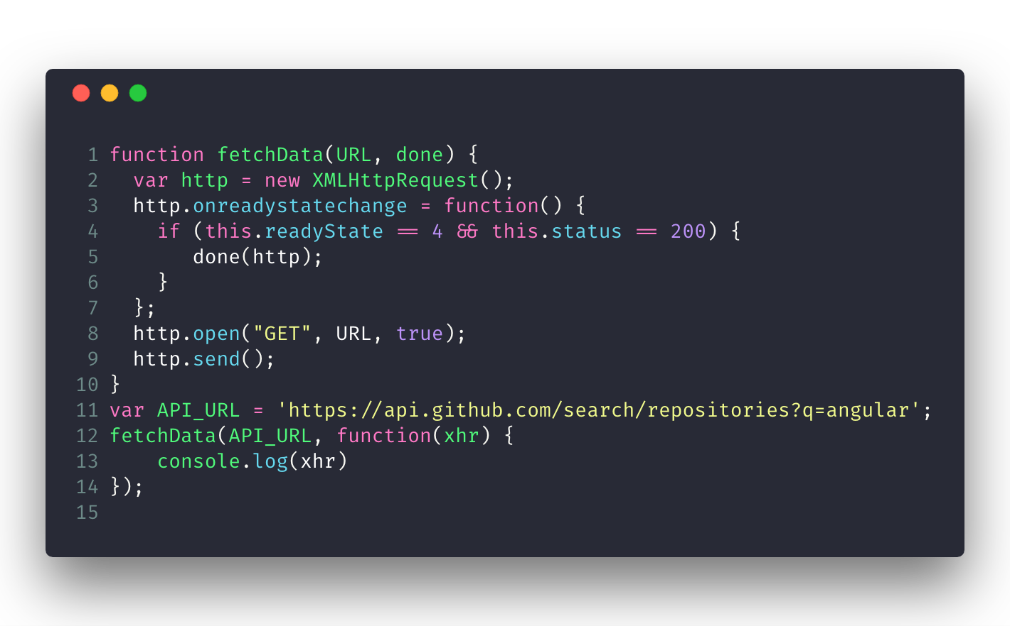
Asynchronous Programming
AJAX

Slide 12
Asynchronous Programming
Asynchronous programming makes it possible to express waiting for long-running actions without freezing the program during these actions.
JavaScript environments typically implement this style of programming using callbacks, functions that are called when the actions complete.
An event loop schedules such callbacks to be called when appropriate, one after the other, so that their execution does not overlap.

Slide 13
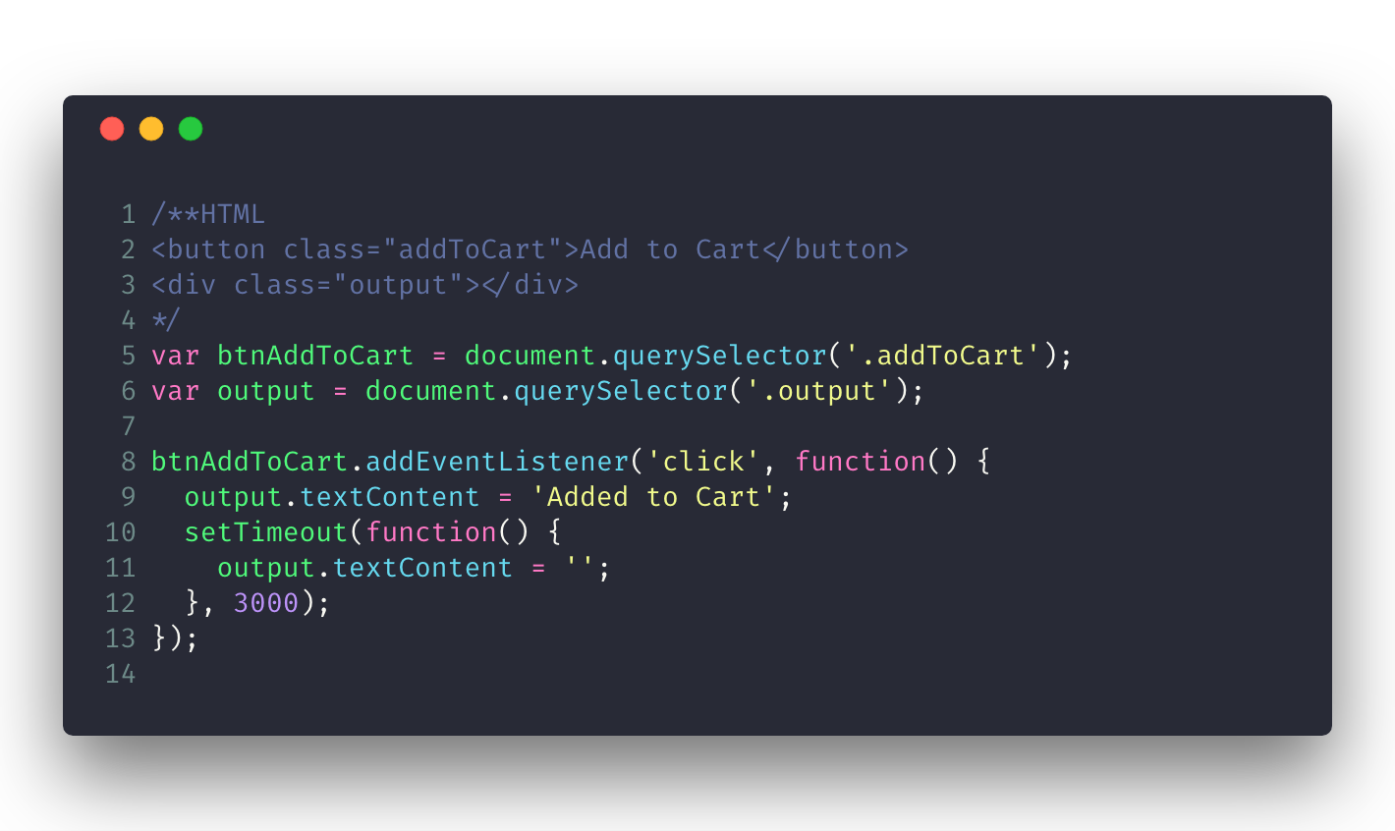
Event
HTML events are "things" that happen to HTML elements.
https://jsbin.com/cibuyereme/edit?html,js,output

Slide 14
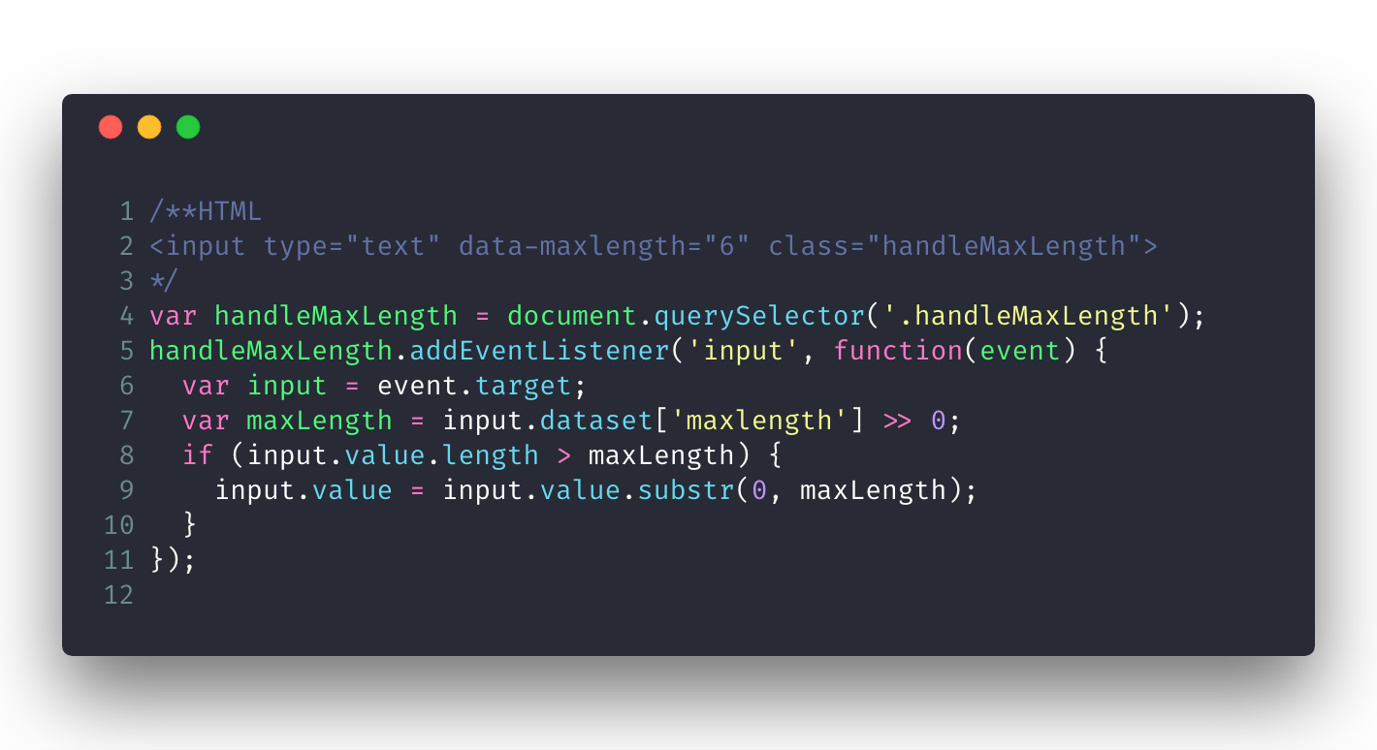
Event
Event objects
https://jsbin.com/sugoviziyi/edit?html,js,output

Slide 15
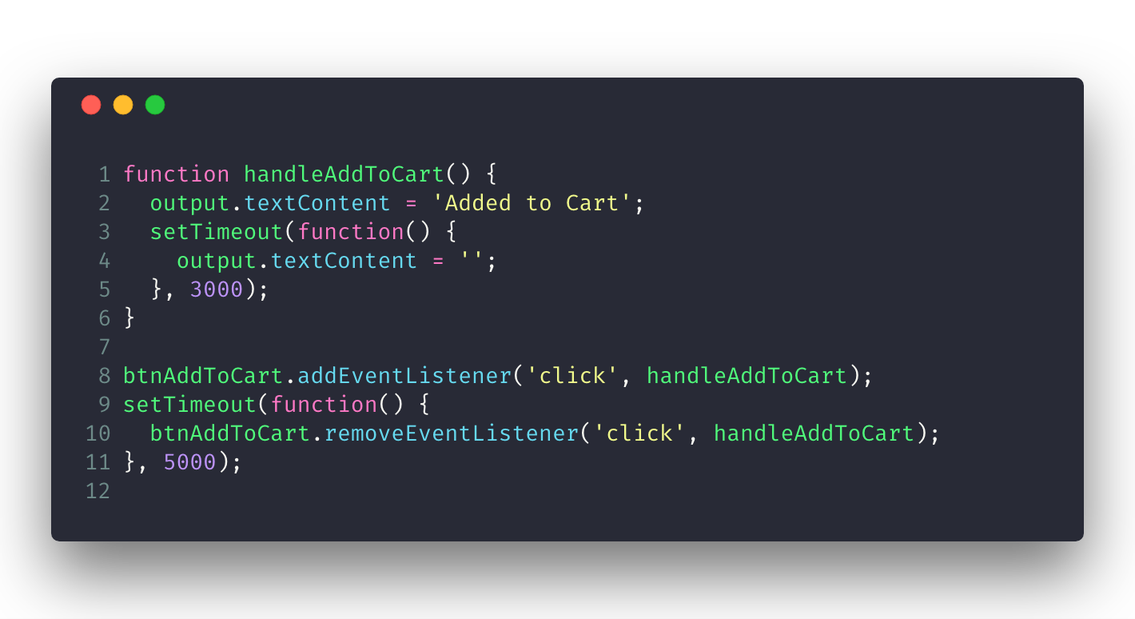
Event
Remove Listener
https://jsbin.com/jodiqafulu/edit?html,js,output

Slide 16
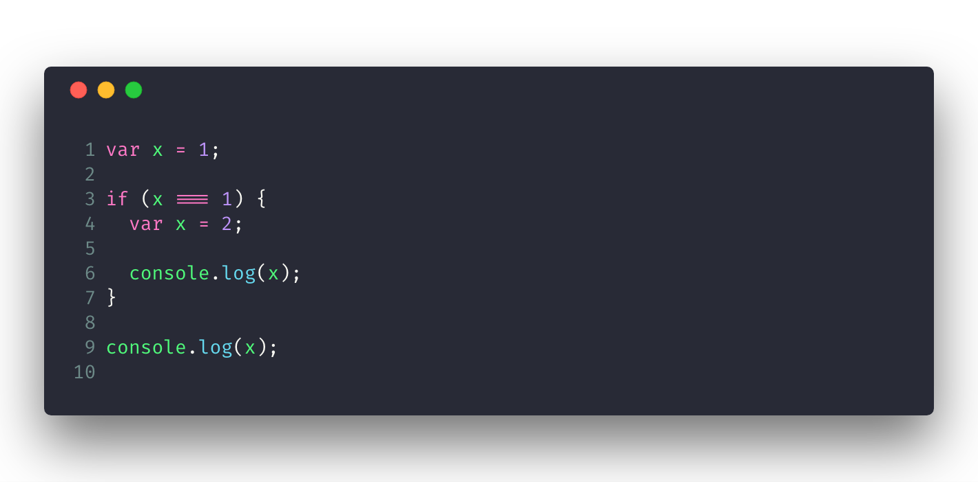
Block Scope Variables
let

Slide 17

Block Scope Variables
let

Slide 18
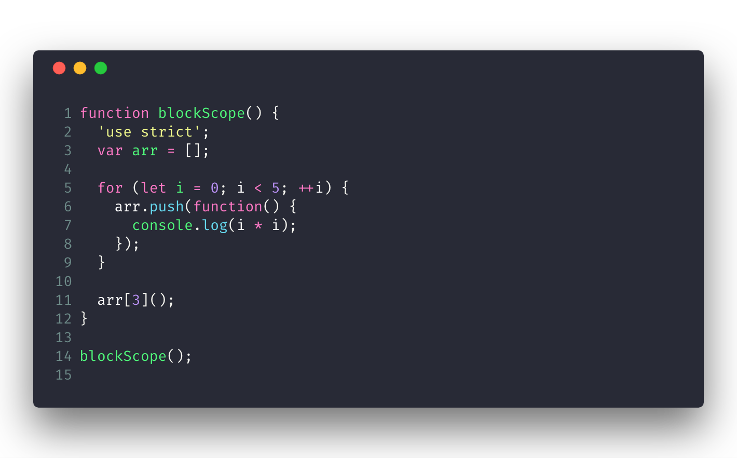
Block Scope Variables
let

Slide 19
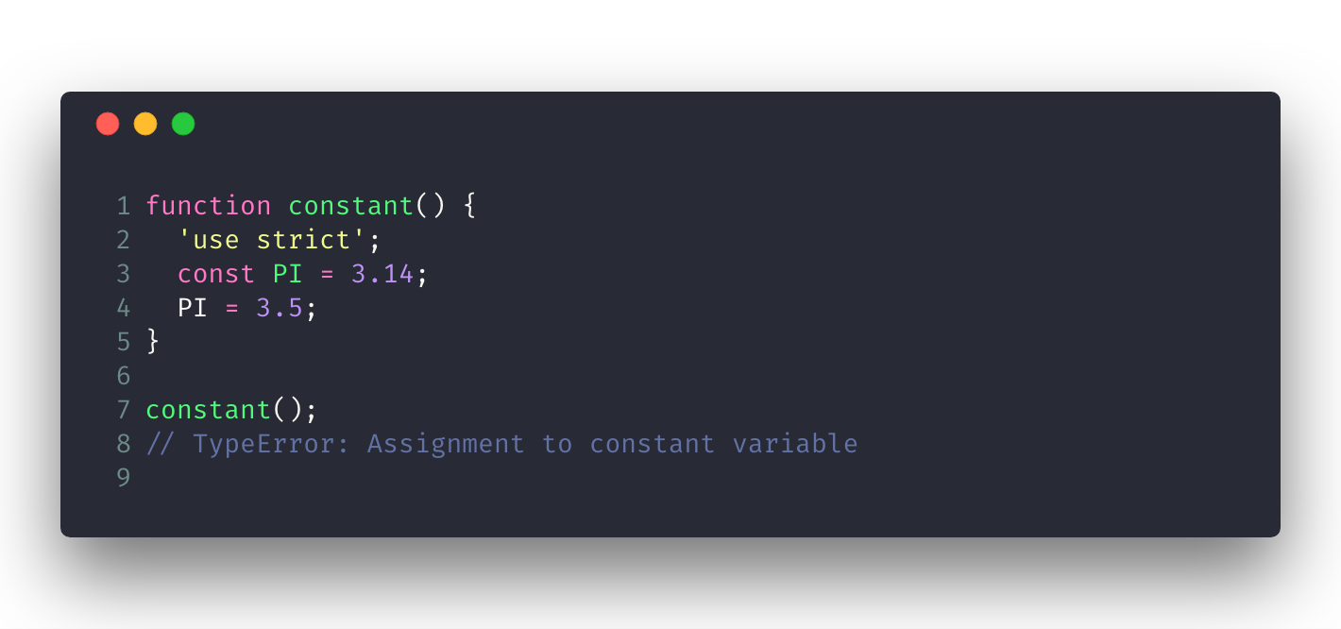
Block Scope Variables
const

Slide 20
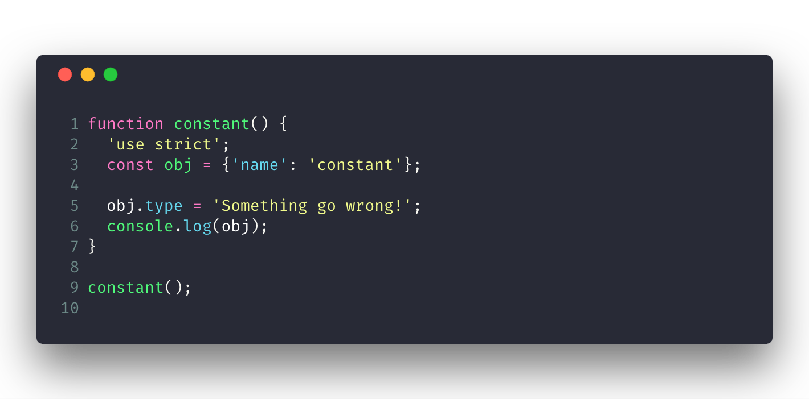
Block Scope Variables
const

Slide 21
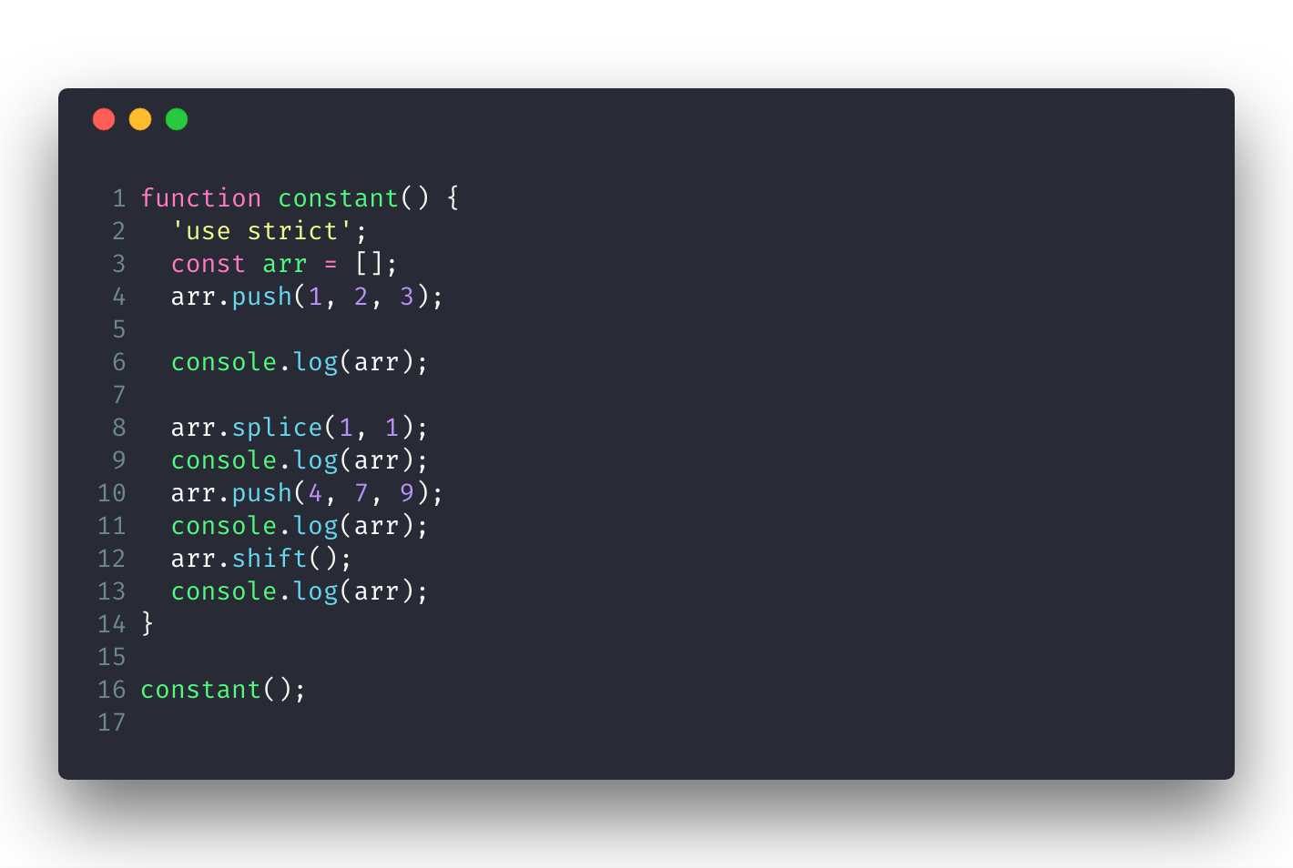
Block Scope Variables
const

Slide 22
Arrow functions, Default parameter value,
Rest, Spread, Class, Module

Slide 23
Functions
A function is a JavaScript procedure—a set of statements that performs a task or calculates a value.
To use a function, you must define it somewhere in the scope from which you wish to call it.

Slide 24
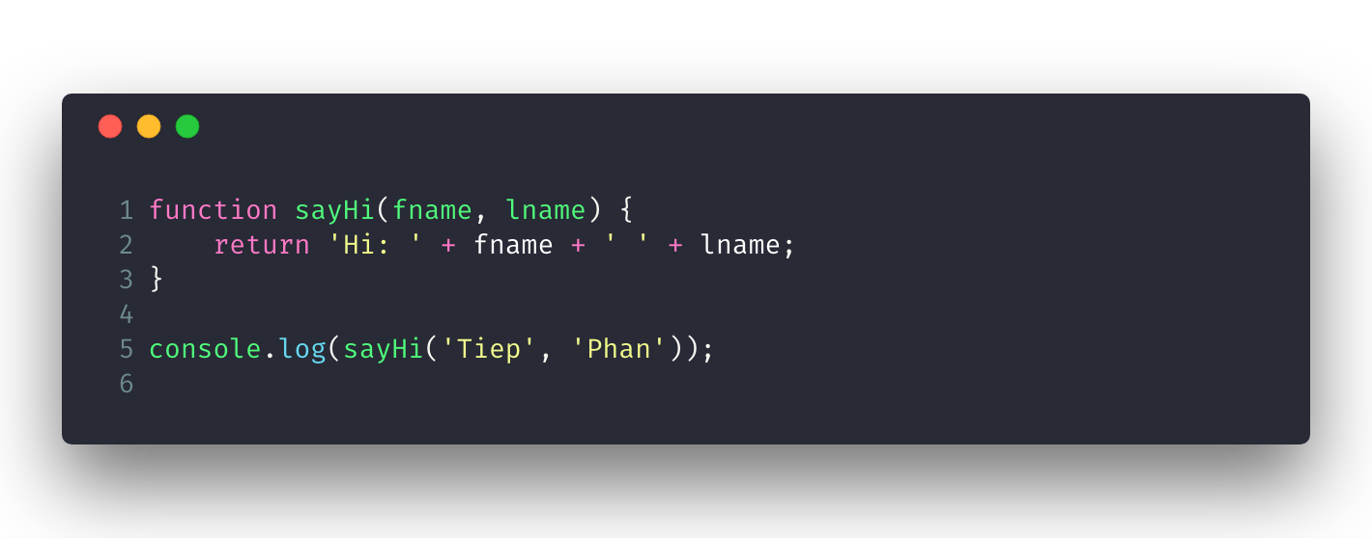
Functions

Slide 25
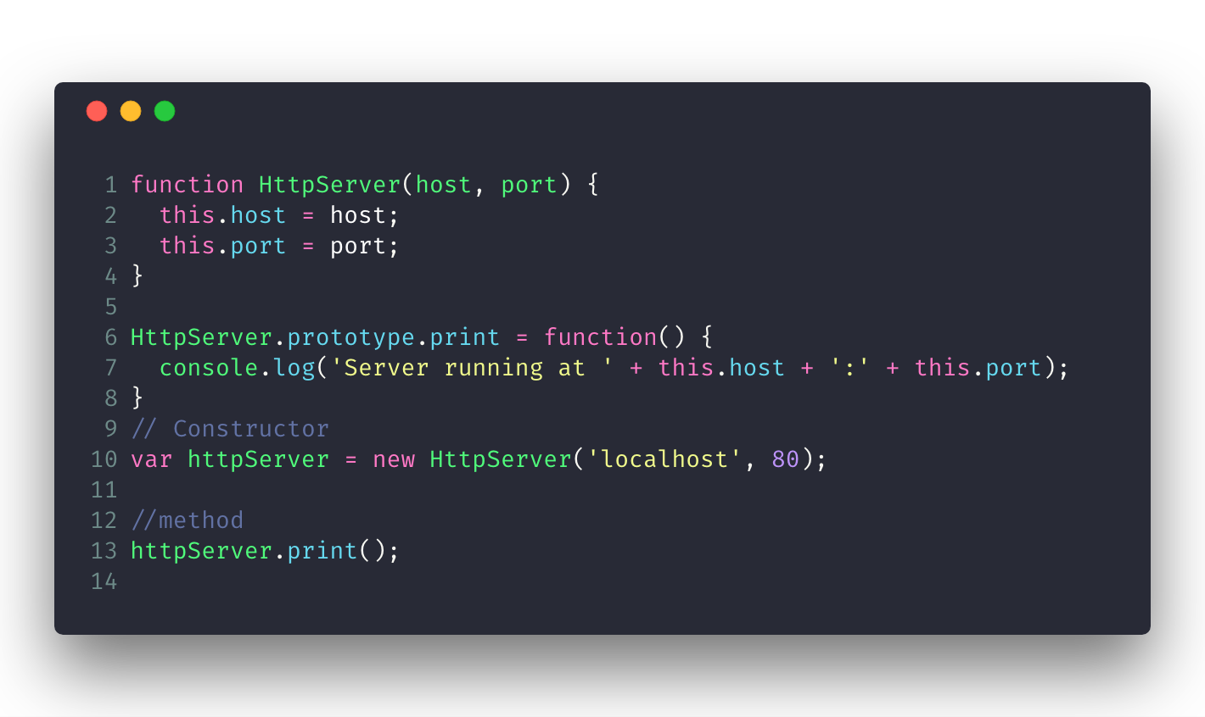
Functions
The Three Roles of Functions in JavaScript:
Non-method function (normal function).
Constructor.
Method.

Slide 26
Arrow Functions
Clean format.
`this` vs Arrow fn.
const arr = [1, 2, 3];
const squares = arr.map(x => x * x);
const obj = {
t: 50,
lazyComp() {
setTimeout(() => console.log(this.t), 1000);
}
}

Slide 27
Arrow Functions
Specifying parameters:
() => { /*CODE*/ } // no parameter
x => { /*CODE*/ } // one parameter, an identifier
(x, y) => { /*CODE*/ } // several parameters

Slide 28
Arrow Functions
Specifying a body:
x => { return x * x } // block
x => x * x // expression, equivalent to previous line
// eg
const squares = [1, 2, 3]
.map(function (x) { return x * x });
const squares = [1, 2, 3].map(x => x * x);

Slide 29
Arrow Functions
No line break after arrow function parameters
const gx = (x, y) // SyntaxError
=> x + y;
const hx = (x, y) => // OK
x + y;

Slide 30
Arrow Functions
Returning object literals
const gx = (x, y) => {x: x, y: y}; // SyntaxError
const hx = (x, y) => ({x: x, y: y}); // OK

Slide 31
Arrow Functions
Arrow functions versus normal functions
An arrow function is different from a normal function in only two ways:
The following constructs are lexical:
arguments, super, this, new.target
It can’t be used as a constructor: Normal functions support new via the internal method [[Construct]] and the property prototype. Arrow functions have neither, which is why new (() => {}) throws an error.

Slide 32
Default Parameter Value
function getPost(perPage = 10) {
console.log(`getPost with ${perPage} items`);
}
function getPost(perPage) {
if (perPage === void 0) { perPage = 10; }
console.log("getPost with " + perPage + " items");
}

Slide 33
Default Parameter Value
Referring to other parameters in default values
function gx(x, y = x) {
console.log(x, y);
}
gx(3)
gx(3, 5)

Slide 34
Destructuring Assignment
The destructuring assignment syntax is a JavaScript expression that makes it possible to unpack values from arrays, or properties from objects, into distinct variables.

Slide 35
Destructuring Assignment
const obj = { first: 'Jane', last: 'Doe' };
const { first: f, last: l } = obj;
// f = 'Jane'; l = 'Doe'
// { prop } is short for {prop: prop}
const { first, last: } = obj;
// first = 'Jane'; last = 'Doe'

Slide 36
Destructuring Assignment
const [x, y] = ['a', 'b', 'c'];
// x = 'a’; y = 'b’;
const [x, , y] = ['a', 'b', 'c'];
// x = 'a’; y = ?

Slide 37
Destructuring Assignment
const obj = {
v: {
g: 5
}
};
const { v: { g } } = obj;

Slide 38
Destructuring Assignment
const [x, y = 10] = ['a'];

Slide 39
Rest Operators
function add(...args) {
return args.reduce((acc, v) => acc + v);
}
add(2, 3, 4, 5)
//14

Slide 40
Rest Operators
const obj = {
a: 5,
b: 10,
c: 35
};
const { b, ...bo } = obj;
const [x, ...y] = ['a', 'b', 'c', 'd'];

Slide 41
Spread Operators
const obj = {
a: 5,
b: 10,
c: 35
};
const ba = {
...obj,
b: 50
};

Slide 42
Spread Operators
const arr = ['a', 'b', 'c', 'd'];
const brr = ['g', 'h', 'i', ...arr];

Slide 43
ES2015 Class
class Shape {
constructor(x, y) {
this.x = x;
this.y = y;
}
moveTo(x, y) {
this.x = x;
this.y = y;
}
}
class Rect extends Shape {
constructor(x, y, w, h) {
super(x, y);
this.w = w;
this.h = h;
}
}

Slide 44
ES2015 Class
Class declarations are not hoisted
// OK
new Shape();
function Shape() {
}
// Error
new Shape();
class Shape {
}

Slide 45
ES2015 Class
class declarations vs class expressions
const Shape = class {
}
const Shape = class S {
}

Slide 46
ES2015 Class
constructor, static methods, prototype methods
class Shape {
constructor(x, y) {
this.moveTo(x, y)
} moveTo(x, y) {
this.x = x;
this.y = y;
} static create(x = 0, y = 0) {
return new Shape(x, y)
}
}

Slide 47
Module Pattern
const dataService = (function() {
return {
getPost: function() {
console.log('GET POST');
}
};
})();

Slide 48
Module Pattern
const dataService = (function() {
let privateData = 50; function updatePrivateData() {privateData += 5;}
return {
getPost: function(refresh = false) {
console.log('GET POST');
if (refresh) {
updatePrivateData();
}
}
};
})();

Slide 49
ES2015 Module
export { name1, name2, …, nameN };
export { variable1 as name1, variable2 as name2, …, nameN };
export let name1, name2, …, nameN; // also var, const
export let name1 = …, name2 = …, …, nameN; // also var, const
export function FunctionName(){...}
export class ClassName {...}
https://developer.mozilla.org/en-US/docs/Web/JavaScript/Reference/Statements/export

Slide 50
ES2015 Module
export default expression;
export default function (…) { … } // also class, function*
export default function name1(…) { … } // also class, function*
export { name1 as default, … };
export * from …;
export { name1, name2, …, nameN } from …;
export {
import1 as name1, import2 as name2, …, nameN
} from …;
export { default } from …;
https://developer.mozilla.org/en-US/docs/Web/JavaScript/Reference/Statements/export

Slide 51
ES2015 Module
import defaultExport from "module-name";
import * as name from "module-name";
import { export } from "module-name";
import { export as alias } from "module-name";
import { export1 , export2 } from "module-name";
import {
export1 , export2 as alias2 , [...]
} from "module-name";
http://exploringjs.com/es6/ch_modules.html https://developer.mozilla.org/en-US/docs/Web/JavaScript/Reference/Statements/import

Slide 52
ES2015 Module
import defaultExport, {
export [ , [...] ]
} from "module-name";
import defaultExport, * as name from "module-name";
import "module-name";
var promise = import(module-name);
http://exploringjs.com/es6/ch_modules.html https://developer.mozilla.org/en-US/docs/Web/JavaScript/Reference/Statements/import

Slide 53
ES2015 Module
You can’t nest import inside if statements, functions, etc.
if (true) {
import { something } from './src/lib';
}

Slide 54
Promise, Async/Await

Slide 55
ES2015 Promise
Promises are an alternative to callbacks for delivering the results of an asynchronous computation.
const p = new Promise( /* executor */ function(resolve, reject) {
// statements
});

Slide 56
ES2015 Promise
A Promise is always in one of three mutually exclusive states:
Before the result is ready, the Promise is pending.
If a result is available, the Promise is fulfilled.
If an error happened, the Promise is rejected.
A Promise is settled if “things are done” (if it is either fulfilled or rejected).
A Promise is settled exactly once and then remains unchanged.

Slide 57
ES2015 Promise
Promise reactions are callbacks that you register with the Promise method then(), to be notified of a fulfillment or a rejection.
A thenable is an object that has a Promise-style then() method. Whenever the API is only interested in being notified of settlements, it only demands thenables (e.g. the values returned from then() and catch(); or the values handed to Promise.all() and Promise.race()).

Slide 58
ES2015 Promise

Slide 59
ES2015 Promise
Create a promise
const p = new Promise(
function (resolve, reject) { // (A)
···
if (···) {
resolve(value); // success
} else {
reject(reason); // failure
}
});

Slide 60
ES2015 Promise
Consuming a Promise
promise
.then(
value => { /* fulfillment */ },
error => { /* rejection */ }
)
.catch(error => { /* rejection */ });

Slide 61
ES2015 Promise
function httpGet(url) {
return new Promise(
function (resolve, reject) {
const request = new XMLHttpRequest();
request.onload = function () {
if (this.status === 200) {// Success
resolve(this.response);
} else {// Something went wrong (404 etc.)
reject(new Error(this.statusText));
}
};
request.onerror = function () {
reject(new Error('XMLHttpRequest Error: '+ this.statusText));
};
request.open('GET', url);
request.send();
});
}

Slide 62
ES2015 Promise
httpGet(
`https://api.github.com/search/repositories?q=angular`
)
.then(
function (value) {
console.log('Contents: ' + value);
},
function (reason) {
console.error('Something went wrong', reason);
});

Slide 63
ES2015 Promise
Other ways of creating Promises
Promise.resolve()
Promise.reject()

Slide 64
ES2015 Promise
Chaining Promises
asyncFunc()
.then(function (value1) {
return 123;
})
.then(function (value2) {
console.log(value2); // 123
});

Slide 65
ES2015 Promise
Chaining Promises

Slide 66
ES2015 Promise
Promise anti-pattern: nested
asyncFunc1()
.then(function (value1) {
asyncFunc2()
.then(function (value2) {
···
});
})

Slide 67
ES2015 Promise
Promise anti-pattern: nested (fixed)
asyncFunc1()
.then(function (value1) {
return asyncFunc2();
})
.then(function (value2) {
···
});

Slide 68
ES2015 Promise
Promise anti-pattern: nested
function asyncFunc1() {
return new Promise(function(resolve, reject) {
asyncFunc2().then(function(data) {
// extra work with data
resolve(data);
}).catch(reject);
});
}

Slide 69
ES2015 Promise
Promise anti-pattern: nested (fixed)
function asyncFunc1() {
return asyncFunc2().then(function(data) {
// extra work with data
return data;
});
}

Slide 70
ES2015 Promise
then always return a promise

Slide 71
ES2015 Promise
Promise.all
Promise and the Event loop
Promise only return single value.
const promise = new Promise(
function(resolve, reject) {
resolve("done");
reject(new Error("…")); // ignored
setTimeout(() => resolve("…")); // ignored
});

Slide 72
Async/Await
Async functions: always return a promise
async function f() {
return 1;
}
function f() {
return Promise.resolve(1);
}

Slide 73
Async/Await
Await: works only inside async functions
async function f() { const promise = new Promise((resolve, reject) => {
setTimeout(() => resolve("done!"), 1000)
});
// wait till the promise resolves (*) const result = await promise; console.log(result); // "done!“
}

Slide 74
Async/Await
Can’t use await in regular functions
function f() { const promise = new Promise((resolve, reject) => {
setTimeout(() => resolve("done!"), 1000)
});
// SyntaxError const result = await promise; }
f();

Slide 75
Async/Await
await won’t work in the top-level code
const response = await fetch(
`https://api.github.com/search/repositories?q=angular`
);
const repos = await response.json();

Slide 76
Async/Await
Async methods
class User {
constructor(username) {
this.username = username;
}
async getUser() {
const response = await fetch(
`https://api.github.com/search/users?q=${this.username}`
);
return await response.json();
}
} const u = new User('tiep');
u.getUser().then(res => console.log(res));

Slide 77
Async/Await
Error handling
async function getUser(username) {
try {
const response = await fetch(
`https://api.github.com/search/users?q=${username}`
);
return await response.json();
} catch(e) {
throw e;
}
}
getUser(`tiep`)
.then(res => console.log(res))
.catch(err => console.warn(err));

Slide 78
Async/Await
Do not combine sync operations with async/await
let x = 0;
async function r5() {
x += 1;
console.log(x);
return 5;
}
(async () => {
x += await r5();
console.log(x);
})();

Slide 79
Async/Await
Do not combine sync operations with async/await
let x = 0;
async function r5() {
x += 1;
console.log(x);
return 5;
}
(async () => {
const y = await r5();
x += y;
console.log(x);
})();

Slide 80
Async/Await
Too Sequential
async function getBooksAndAuthor(authorId) {
const books = await fetchAllBook();
const author = await fetchAuthorById(authorId);
return {
author,
books: books.filter(book => book.authorId === authorId),
};
}

Slide 81
Async/Await
Too Sequential
async function getBooksAndAuthor(authorId) {
const bookPromise = fetchAllBook();
const authorPromise = fetchAuthorById(authorId);
const books = await bookPromise;
const author = await authorPromise;
return {
author,
books: books.filter(book => book.authorId === authorId),
};
}

